Slide 1
Staff Collaborative Workshop Community Building Skills

Slide 2
What do we mean by ‘community building skills’?
Where do they have relevance within EduSpots?
Why are they valuable to EduSpots?

Slide 3
Where they are used in EduSpots…
Staff team
Local volunteer teams
EduLit volunteers
EcoSTEM volunteers
Ignite Girls volunteers
EduKidz volunteers
Spot Ops volunteers
Ambassadors Network
On social media with wider network
Trustees team
Fundraising

Slide 4
Think of an example when you joined a community and became an active member. What set the conditions for this? Who took what actions? My example: Invicta Academy

Slide 5
What are some key aspects to community building?
Inspiring people towards a vision through authentic leadership – generating a sense of alignment.
Building personal relationships (with and between volunteers)
Showing them how their contribution matters
Giving them a voice in decision-making
Giving them opportunities
Setting an example, yourself

Slide 6
Let’s produce some practical examples of each of these within our own contexts!

Slide 7
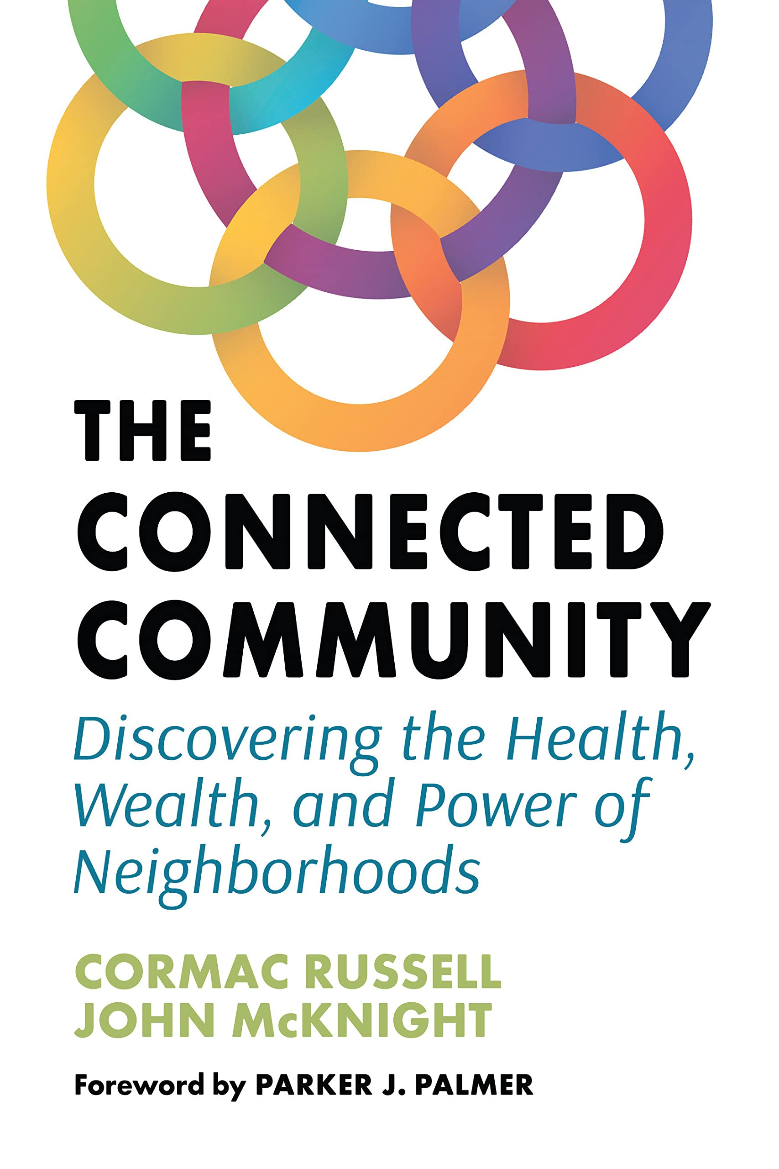
“A culture of connectedness is fostered through story sharing. The sum of the adaptation of such stories over time is known as culture: local cuisine, art, beliefs, language, customs, and so fourth. Culture finds voice through stories.”

Slide 8
‘We are a part of this place, not apart from this place. We are not going to use it. We are going co-thrive and co-create. We can live well as a part of this place if we do our part; we can’t live in it if we exploit it, because to exploit this place, is to exploit ourselves – we are one.’ Cormac Russell and John McKnight.

